Slide 1

predicting future Stock Prices using machine learning
Chang-Joon Lee Ph.D
Analyst Developer / Data Scientist

Slide 2


Bio
Education
Data Science
Ph.D. in Biomedical Engineering
Experience
Analyst Developer (from 2023)
Research Scientist
Skills
Data Analysis
Visualisation
Machine Learning
Programming

Slide 3

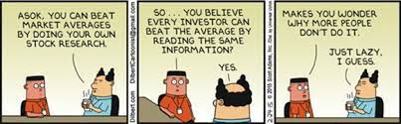
Are we just lazy?
For Average Retail Investors (Non-Professional Traders):
INFORMATION OVERLOAD
LACK of BACKGROUND KNOWLEDGE and TIME
Prone to PANIC SELLING
BEHAVIOURAL BIAS
HOW CAN WE HELP?
Source: Dilbert.com

Slide 4
Business objective
Stakeholder:
RETAIL INVESTORS
“How much more investment return can we provide to our stakeholders by providing easy and ACCURATE future stock price forecast?”
Especially relevant in current post-pandemic economic climate muddled with uncertainty, where another recession is looming.
We need to find a way to MINIMISE our LOSS, or even use it to our ADVANTAGE in making PROFIT.

Slide 5
Modelling objectives
“develop an APP that can automate the process of:
Gathering financial and economic data
Forecast future stock prices”
Build a PREDICTIVE MODEL based on machine learning algorithms to ACCURATELY FORECAST:
30-Days Future Prices
2-Years Future Prices

Slide 6
Gather necessary data
STOCK MARKET INDICES:
S&P 500 Index
Dow Jones Industrial Index
Nikkei (Tokyo) Index
FTSE (London) Index
Hang Seng (Hong Kong) Index
U.S. Treasury Bond
INVESTOR SENTIMENT:
U. of Michigan Consumer Sentiment
NYT News Article Sentiment
COMPLETE DATASET
COMMODITY PRICES:
Gold
Silver
Crude Oil
ECONOMIC INDICATORS:
Gross Domestic Product
Unemployment Rate
Consumer Price Index
Median Income
TECHNICAL INDICATORS:
Moving Average
Bollinger Bands
Relative Strength Index
Sources: Yahoo Finance, Federal Reserve Bank, NASDAQ, Alpha Vantage, New York Times API

Slide 7
Pre-processing the data
Target Variable: Daily CLOSE Value of S&P 500 Index.
Daily Opening, High, Low Values and Volume of Stocks Traded for S&P 500 included.
Only Close value for other market indices included.
Technical indicators manually generated.
Only data from 1st Jan 1990 to 31st Dec 2019 were considered.
Some values are given as monthly, quarterly or annually. We assumed a value on a particular day carries on to the next day and onwards until there is a new value recorded.
Final Dataset: ~10,000 daily records with 26 features

Slide 8
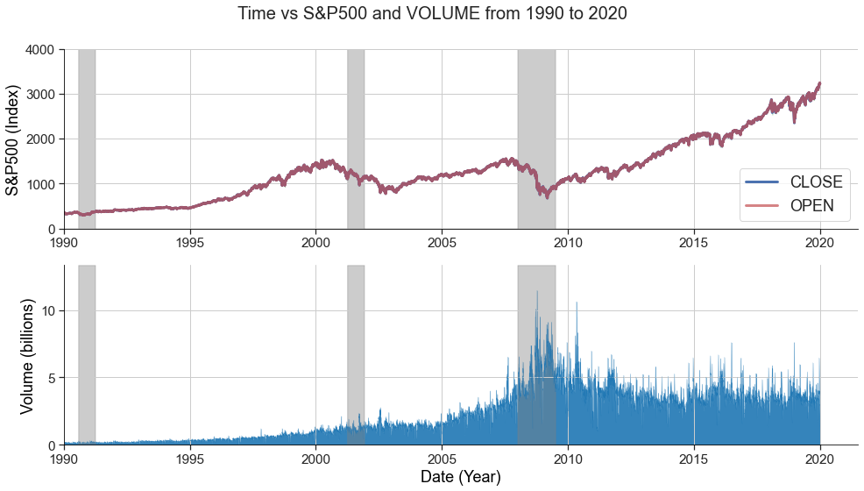
EDA insights - S&P 500
Gradual INCREASE in value from 1990 to 2020.
Sharp DECLINE in value during recessions.
Largest decline during the Great Recession (2007).
RECORD VOLUME of stock traded during the Great Recession.
RECESSION

Slide 9
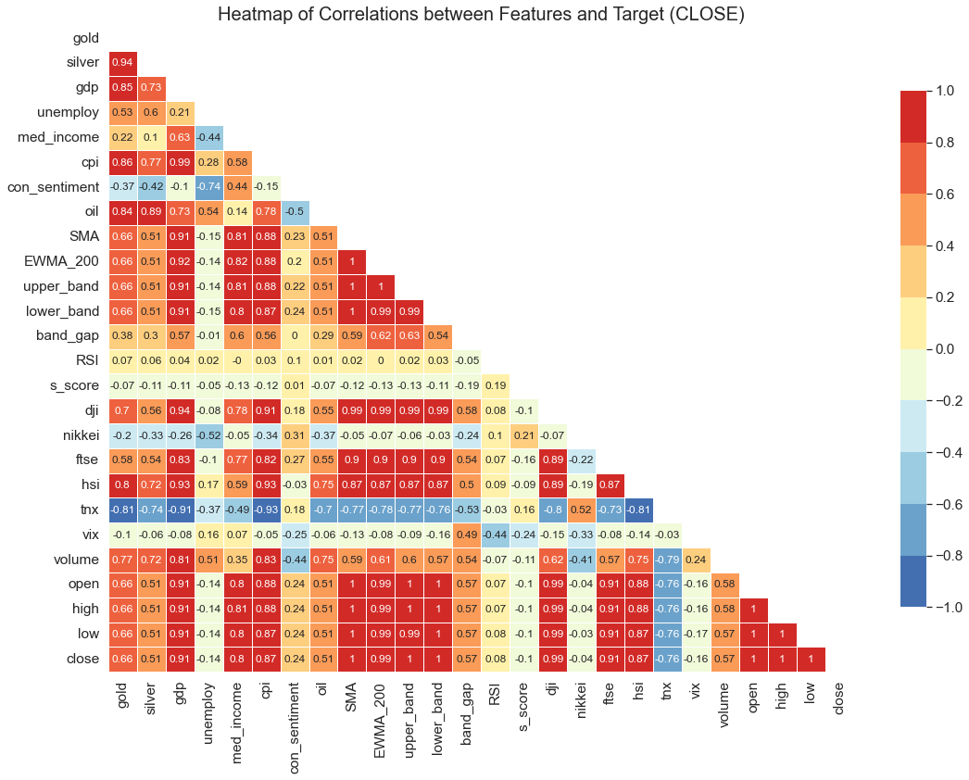
EDA insights – CORRELATIONS
Very STRONG correlation (>0.95) between:
Gold vs Silver
GDP vs CPI
Dow Jones vs S&P 500
These variables are REMOVED to avoid multicollinearity.
RSI and Nikkei have very WEAK correlation to S&P 500 (<0.1).
S&P 500 most STRONGLY correlated to:
GDP, FTSE, HSI and Median Income
S&P 500 NEGATIVELY correlated to TNX and Unemployment.

Slide 10
Machine learning process
TRAIN DATA
(1990 – 2017)
CLASSICAL MODELS:
Autoregressive (AR)
Autoregressive Integrated Moving Average (ARIMA)
Multivariate
Multi-Output Model
TEST DATA
(2018 – 2020)
LINEAR REGRESSION:
Univariate
Multivariate
Make Prediction for the Next 30 Days Based on the Past 14 Days of Data:
Each feature will contain 14 LAGGING features (X_{t}, X_{t-1}, X_{t-2}, … , X_{t-14}).
Past records of target variable also becomes a training feature.
MULTIPLE target variables spanning from present day to the next 30 days (Y_{t}, Y_{t+1}, Y_{t+2}, … , Y_{t+30})
Results in 308 training features (22 x 14) and 30 output variables.
NONLINEAR REGRESSION:
Support Vector Regression
Random Forest Regression
XGBoost Regression
TEST CRITERIA:
30-Days Forecast
2-Years Forecast
Use Root Square Mean Error
(RMSE)
DEEP LEARNING:
Multi-Layer Perceptron
Long-Short Term Memory

Slide 11
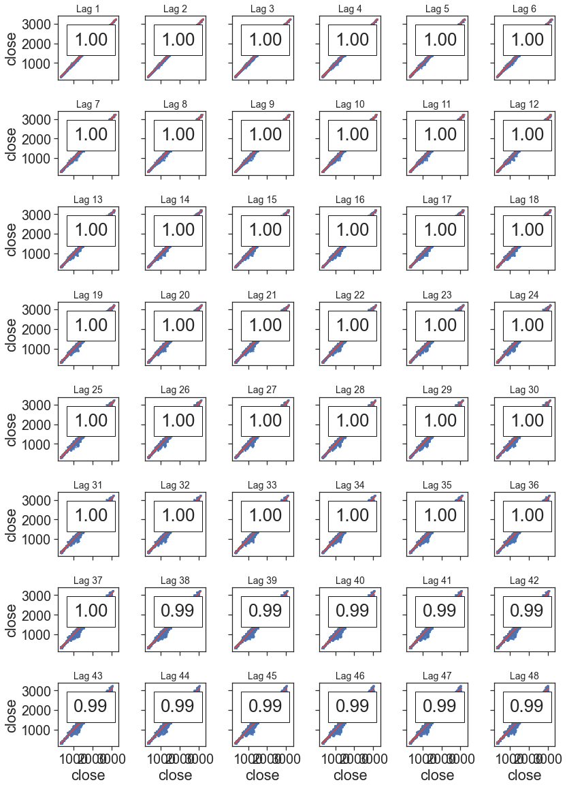
ML – Lagging features
A “lag” is a fixed amount (day) of passing time.
There is a VERY STRONG correlation between the present value and lag values even up to lag 48 (i.e. values from 48 days before)
POSITIVE AUTOCORRELATION is present in the data.
This means past values have a very strong influence on the current value.
No seasonality is observed.

Slide 12
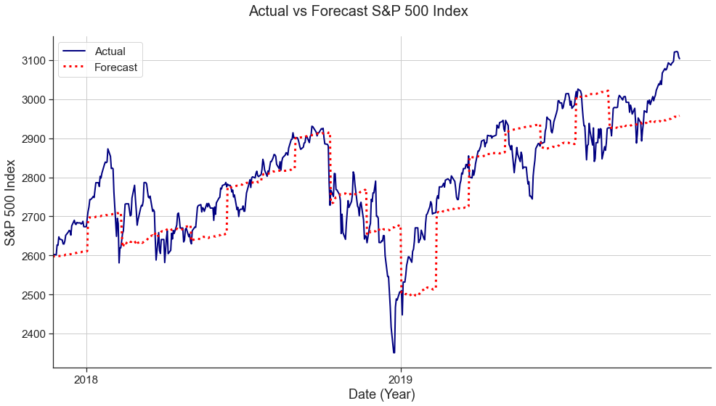
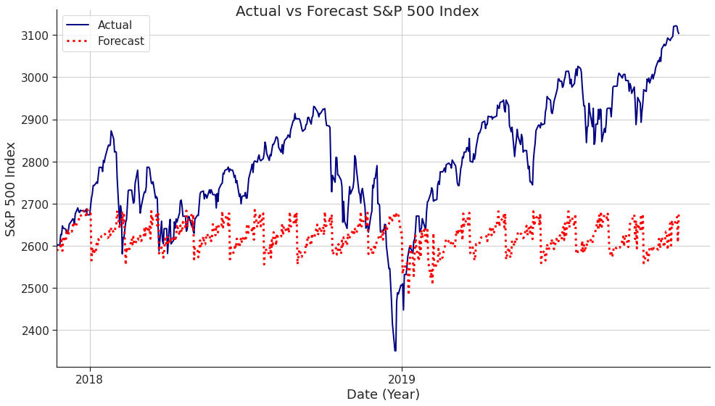
ML – Nonlinear model
Linear Regression 2-Years Forecast
Random Forest 2-Years Forecast
TRAIN RMSE: 36.90
TEST RMSE: 85.61
TRAIN RMSE: 7.94
TEST RMSE: 225.56

Slide 13
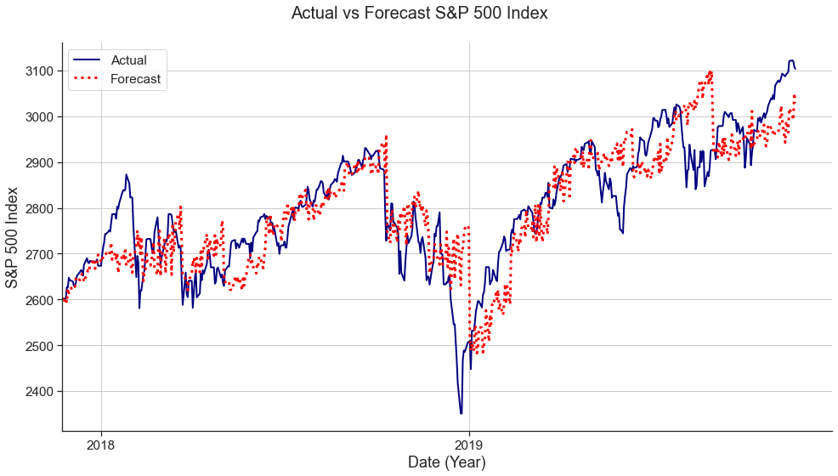
ML – HYBRID MODEL
Linear Regression 2-Years Forecast
LR + RF 2-Years Forecast
TRAIN RMSE: 36.90
TEST RMSE: 85.61
TRAIN RMSE: -
TEST RMSE: 81.24

Slide 14
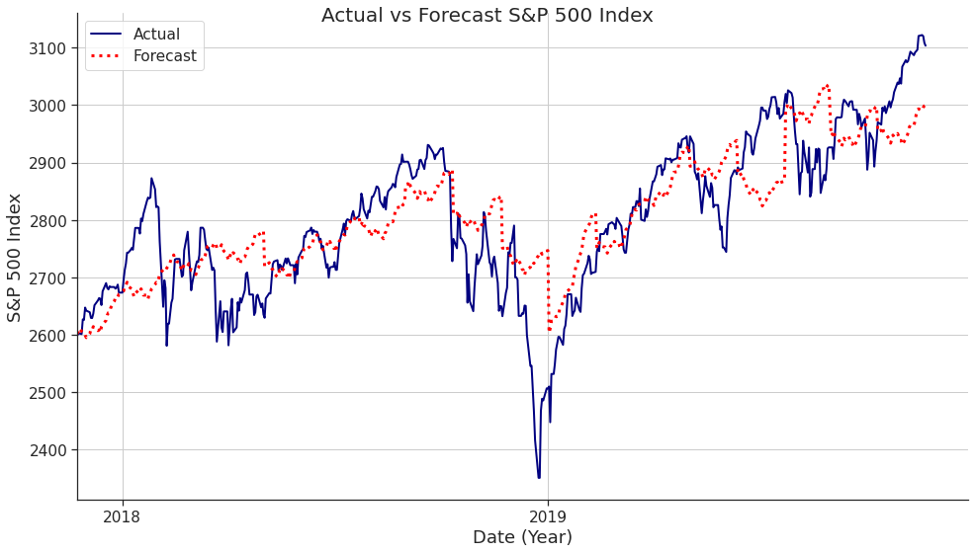
ML – deep learning
LR + RF 2-Years Forecast
Multi-Layer Perceptron 2-Years Forecast
TRAIN RMSE: -
TEST RMSE: 81.24
TRAIN RMSE: 24.55
TEST RMSE: 84.52

Slide 15
SUMMARY OF RESULTS
RMSE
BEST OVERALL MODELS
(AVG. ERROR 1%)

Slide 16
CONCLUSION
Final Model: LR + RF Hybrid Model (average error ~1%).
Source code for automatically gathering data and building the model available on GitHub.
Requires FURTHER FINE TUNING
For our stakeholders (retail investors):
During late 2018 – early 2019 there was a steep fall in stock price from ~2600 to ~2400 but the market recovered back to its original position within a couple of months.
PERFECT OPPORTUNITY TO
BUY LOW & SELL HIGH!!
Simple Forecast: No Increase
NO GAIN
Our Forecast: STEEP INCREASE
GAIN OF +10% RETURN
$10,000 Investment ☛ $1,000 PROFIT
For comparison, you will earn $14 from a 30-day term deposit of $10,000 (1.7% p.a)

Slide 17



GOING FORWARD
ONE-CLICK FORECAST
SOURCE CODE
DEPLOYMENT
GITHUB
HEROKU
RE-TRAIN MODEL (BI-ANNUALLY)
WEB-BASED APP
BY THE DEVELOPER

Slide 18





THANK YOU
CHANG-JOON LEE
chang-joon.lee@outlook.com
linkedin.com/in/chang-joon-lee
github.com/oneway1225
medium.com/@cjlee-data

